Slide 1


ELEC5619 – Object Oriented Application Frameworks
Songqing Gu
School of Electrical and Computer Engineering
The University of Sydney
The University of Sydney Page 1

Slide 2
Authentication vs Authorization
Authentication verifies who you are by validating credentials.
Authorization determines what an authenticated user can do by checking privileges and roles.
Role A
User 01
Privilege - 01
Role B
Privilege - 02
User 02
Privilege - 03

Slide 3
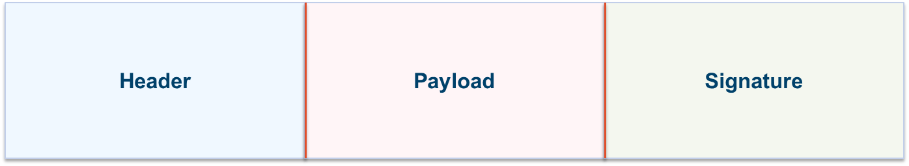
JWT Structure & Usage
Header:
Specifies algorithm & token type
Signature:
Signed with secret to protect data integrity
Payload:
Contains claims (issuer, subject, expiry, etc.)
Self-contained JSON object, used for stateless authorization and information exchange in web applications.
Send JWTs in the HTTP Authorization header (Bearer token) and verify signature on server.

Slide 4
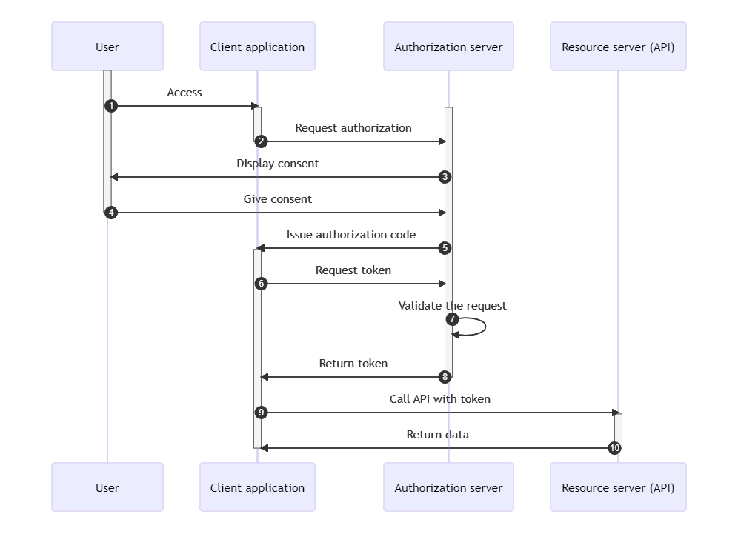
OAuth2 Authorization Code Flow
User logs in & grants consent; authorization server sends authorization code to redirect_uri
Client exchanges the code for an access token at the token endpoint
Client uses the access token to call the resource server

Slide 5
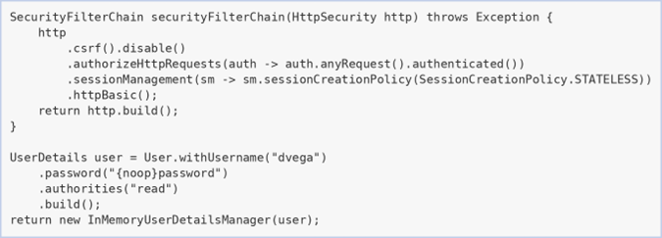
Implementing Authentication & Authorization
Configure a SecurityFilterChain
Disable CSRF & enforce stateless sessions for APIs
Require authentication for all endpoints
Define user details & passwords

Slide 6
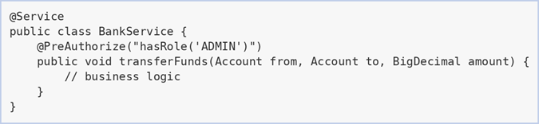
Securing REST APIs
Use stateless sessions
Validate JWTs on every request
Enforce least privilege through roles
Apply method-level security with annotations

Slide 7
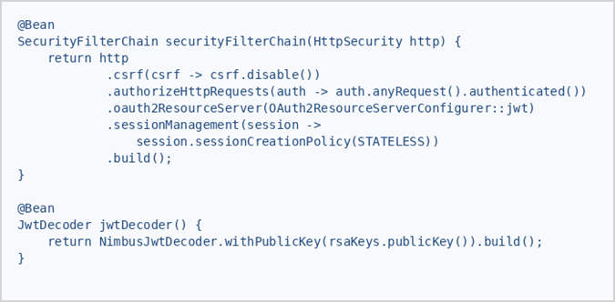
Configuring JWT Resource Server
Include spring-boot-starter-oauth2-resource-server dependency
Disable CSRF & require authorization for all requests
Enable JWT via oauth2ResourceServer and use stateless sessions
Define a JwtDecoder bean using your RSA public key

Slide 8
Contents
Software Testing

Slide 9
Testing Strategies in OOAD
- When testing takes place in the SDLC (what, how)
- The strategies and tools associated with testing practice:
- Unit Tests
- Service Tests
- Integration/System Tests/end to end
- UAT Tests
Test methodology
- Test pyramid (quantity, complexity and cost )
- Shift left testing
The process to perform testing practice (Testing lifecycle)
- requirement analysis
- Test plan
- Test case development
- Test environment setup
- Test execution
- Test closure

Slide 10
SLDC V-Model
Development lifecycle
Testing lifecycle
Business requirement
Acceptance testing
System requirement
System /
integration testing
Verification phase
High level Design
Validation phase
Service testing
Low level Design
Unit testing
Coding

Slide 11
Unit Testing

Slide 12
Unit Testing
Smallest testable unit
A white box testing, drafted by developers,
Code coverage, a measurement of the amount of code that is run by unit tests - either lines, branches, and methods, is often > 95%
TDD, the methodology where we create test cases before and in ongoing implementation.
How is class testing different from conventional testing?
Conventional testing focuses on input-process-output, whereas unit testing focuses on each method, then designing sequences of methods to exercise states of a class

Slide 13
Unit Test Case Best Practices
Follow naming convention (name should be insightful)
"Arrange, Act, Assert" pattern – common approach
- Arrange your objects, create, and configure them as necessary
- Act on an object
- Assert that something is as expected
Mock external service
Automated unit testing tools facilitate these requirements

Slide 14
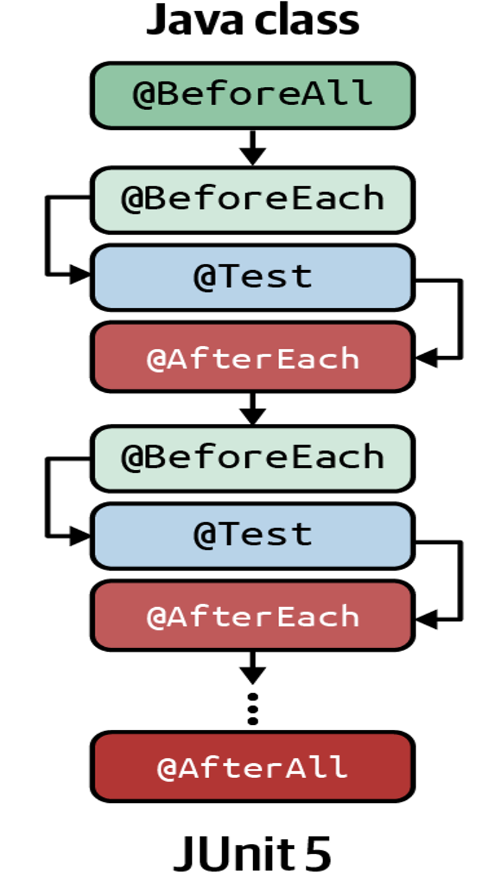


Unit testing framework for Spring boot
Java Unit test framework
Mock dependencies (e.g. database)
Define stubbing behavio

Slide 15
Service Testing

Slide 16


Functional test primarily
API - service contract
Traffic from clients
API endpoints
Remote system
interface layer
service layer
integration layer
TESTING SCOPE

Slide 17
Integration Testing

Slide 18
Why Integration Testing?
Monolithic architecture style
WEB APPLICATION
BUSINESS SERVICE
CONCEPTUAL MODEL OF A SIGNLE WEB APPLICATION

Slide 19

Why Integration Testing?
Micro-service architecture style
Credit card
Account management
WEB
APPLICATION
ORDER
MANAGEMENT
Messaging server
Inventory management
Credit checking
Customer management
TESTING SCOPE

Slide 20
Integration Testing
Integration tests verify that different modules or services in your overall application work well together. It is to test interactions across systems.
For example, it can be testing the interaction with the database or making sure that microservices work together as expected.
These types of tests are more expensive to run as they require multiple parts of the application to be up and running

Slide 21
System /End to End Testing

Slide 22
Types of System Testing
Validates that the system performs its intended functions according to business requirements
Functional testing
Performance testing
Measures how well a system performs under various conditions, including speed, load, and stability. Key metrics include response time, throughput, current users, memory usage, CPU usage …
Load testing
Stress testing
evaluating systems, networks, and applications to find vulnerabilities and flaws that attackers could exploit, thereby protecting sensitive data and maintaining system functionality
Security testing
Regression Testing ensures new changes don't break existing functionality
Recovery Testing checks system resilience from failures
and. more …

Slide 23
User Acceptance Testing

Slide 24
User Acceptance Testing
UATs are the final phase of the software development lifecycle. they verify if a system satisfies business requirements.
They are normally executed by system owner when system developed by delivery team handles over to owner.
They require the entire application to be running, and deployment environment is very closed to production environment.

Slide 25
Testing Methodology

Slide 26
Test pyramid
System/
End 2 end testing
Smaller, cheaper testing
Integration testing
Larger, more expensive tests
Black box testing
White box testing
Unit testing
Quantity of testing

Slide 27
Shift-left Testing
Business requirement
Acceptance testing
System requirement
System
integration testing
High level Design
Service testing
Shift left
Low level Design
Unit testing
Coding

Slide 28
A Typical Use Case – Contract Testing
API contract Broker
Download API file
1
Public API file
2
Service Client
Service provider
3
run API compatibility in unit test manner
late testing in the cycle leads to:
Increased costs owing to bug discovery at a later stage
Longer bug fix times
the benefits of shift left testing:
Reduced costs involved in fixing bugs
Improved efficiency and reduced time in the overall software development lifecycle

Slide 29
Software Test life cycle - STLC

Slide 30
Understands the requirements like what is to be tested.
Define a detailed plan for the testing activities that will be performed, and a clear understanding of the testing objectives, scope, and deliverables.
Requirement Analysis
Test Plan
Prepare the detailed test cases and test data
Test Case Development
The test cases/scripts are run against the software application to identify any defects or issues
Setup right testing environment, equipped with various related tools, server, hardware, and network.
Test Environment Setup
Test Execution
Test Closure
all testing-related activities are completed and documented

Slide 31
Requirement Analysis
Activities
Identify customer needs and types of tests.
Gather details about requirements.
Prepare Requirement Traceability Matrix (RTM).
Identify test environment details.
Automation feasibility analysis.
Deliverables
Requirement Traceability Matrix (RTM).
Automation feasibility report (if applicable).
Entry Criteria
Exit Criteria
client requirements,
acceptance criteria
intended product architecture to be documented.
aim for a requirement traceability matrix (RTM)
decision of automation.

Slide 32
Requirement Analysis
Epic
Feature
Requirement organization
represents the highest level of requirement, representing business initiatives
User Story
A feature is a concrete, actionable item
Think of a feature as a smaller offshoot of its epic
Task
Single, well-defined functionality
Shown in your backlog
Completed within one sprint

Slide 33
Test Plan
Preparation of test plan documents for all types of testing.
Selection of test tools.
Test effort estimation.
Resource planning and deciding roles and responsibilities.
Training requirement.
Activities
Deliverables
Test plan document.
Effort estimation document.
Entry Criteria
Exit Criteria
Report the implemented test strategy.
Testers should have approval on the test plan’s risks and costs.

Slide 34
Test Plan Attributes
Objectives
Risk
Scope
Backup/Mitigation Plan
Methodology
Approach
Assumption
Schedule
Role and Responsibility
Defect Tracking
Test Environment
Test Automation
Template
Deliverables
Effort Estimation

Slide 35
Test Case Development
Activities
Creation of test cases and automation scripts
Review test cases and scripts.
Create test data (If Test Environment is available).
Deliverables
Test cases/scripts.
Test data.
Entry Criteria
Exit Criteria
Approval of timelines to execute the test plan.
Approval of test cases and automation scripts.

Slide 36
Test Case Development
Epic
Test plan
Feature
Test Suit
User Story
Test Case
Behavior Driven Development, BDD
as an evolution of Test-Driven Development (TDD)
BDD emphasizes testing the overall behavior of the application from a higher, user-oriented perspective.
Defining the behavior of an application in plain, human-readable language in “Given-When-Then” format – Gerkin.

Slide 37
Sample Test Case
Feature: Login
As a new user
I want to log in to the website
So that the system can remember my data
Scenario #1: Successful Log in to the website
Given A user brings up the login pop-up
When A user clicks Sign-in
And A user enters a valid email <email> and password <password>
And A user clicks Sign-in
Then A user should be successfully logged into the site
Scenario #2: Unsuccessful Log in to the website
Given A user brings up the login pop-up
When A user enters an invalid email <email> and password <password>
And A user clicks Sign-in
Then A user should not be successfully logged into the site

Slide 38
Test Environment Setup
Activities
keep the test environment ready by understanding the required architecture, environment setup, and preparing a hardware/software requirement list.
Setup test environment and test data.
Perform a smoke test on the build.
Deliverables
Test Environment ready with the prepared test data.
Smoke Test Results.
Entry Criteria
Exit Criteria
Have a defined system design and project architecture.
Have a working QA/Testing environment set up to run test cases.

Slide 39
Test Execution
Execute test cases according to plan.
Generate a test report and log defects for failed cases.
Map defects to test cases in RTM.
Perform Retest.
Track the defects to Complete the test.
Activities
Deliverables
Completed RTM with the execution status.
Test cases updated with a pass or fail results.
Defect reports.
Entry Criteria
Exit Criteria
Have all the previous steps completed, especially the exit criteria.
Document test execution and results to report them back.

Slide 40
Test Automation Strategy
Reducing manual testing, hence reducing quality costs
Minimizing maintenance and increasing portability of tests
provision test environment – Staging, UAT
Select right tool and test framework:
- UI: Selenium, Playrgiht, etc.
- API: Postman, HttpClient, Karate, etc.
- Mobile: Apium
Automated by CI/CD pipeline

Slide 41
Test Closure
Activities
Evaluate test cycle closure completion criteria based on Time, Test coverage, Cost, Software, Critical Business Objectives, and Quality metrics.
Prepare test metrics based on the above parameters.
Prepare Test closure report.
Test result analysis to find out the defect distribution by type and severity.
Deliverables
Test Closure report.
Test metrics.
Entry Criteria
Exit Criteria
Test results and logging from the previous phases..
Delivered planned deliverables
approved test closure test summary report

Slide 42
Thank you

